Slide 1
Open AI Hackathon
Mentor :- Akash Deep Saxena
Harsh Rai :: Anmol Chopra :: Vaishnavi Singh :: Bharat Shakya
Team
“SENORITA”

Slide 2




Problem Statement :- Use Open AI to create Shell Script from Natural Language.
Challenge Details
Objective
Fetch and import Project from Github (https://github.com/mittal-tarun/codex-challenges)
Create a windows cmd utility to accept list of instruction in text file as input
Use Open AI to generate a Power Shell Script based on the instruction in the text file .
Expected Output
Error free Power Shell script.
Open AI Prompt and Settings
Criteria
Quality of code structure
Creativity in Open AI Prompt
Problem Statement
Notes:
Can you please update the slide’s content if necessary?

Slide 3




Traditional Way of Execution!
> Fetching Text instructions from Git Hub
> Generate Shell Script Manually
> Bug Fixing in the Script
> Generate Test Cases for the Script Manually
> Run Test
> Deploy
Traditional Way of Execution

Slide 4

How We Executed through Open AI?
Passed the instructions generated in requirement.txt file to OpenAI
Open AI Generated CMD Utility
Ran CMD utility in Windows and created Requirement.txt
Fetch Text Instructions from Git Hub
PowerShell Script Generated
How We Executed?

Slide 5
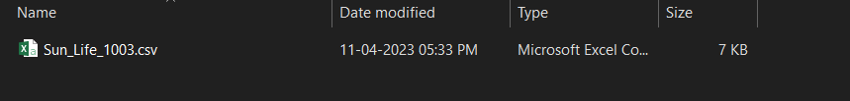
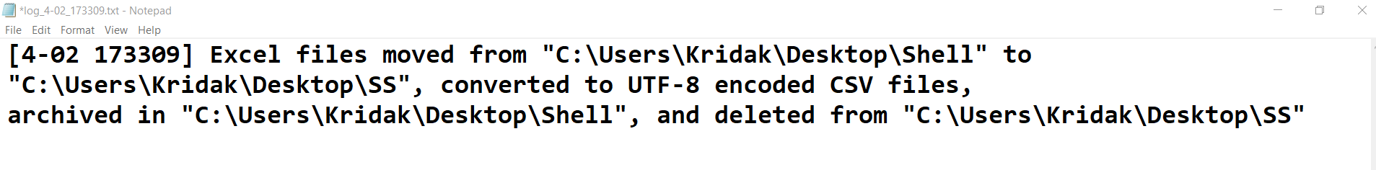
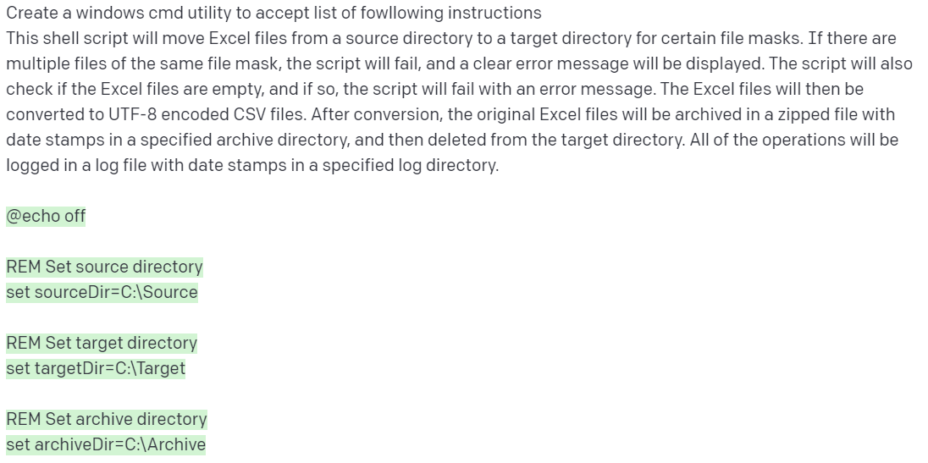
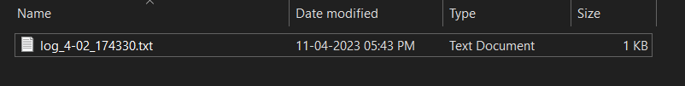
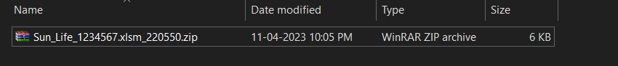
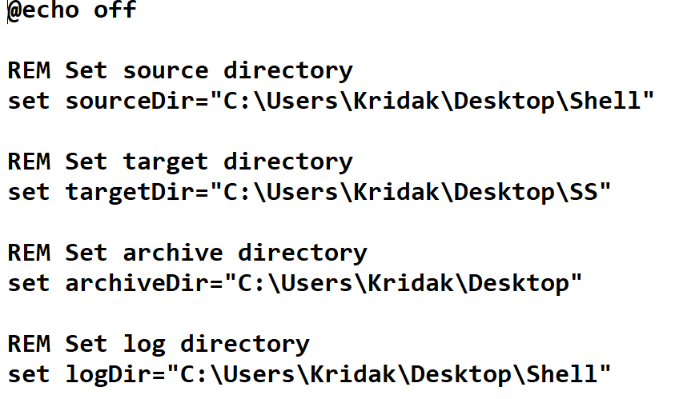
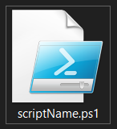
Visual Process
Instructions.txt file fetched from GitHub
Log Generated by the OPEN AI generated script
File Moved and Converted to CSV
Prompt Given to Open AI
Shell Script Generated By Open AI
Utility
Ran Script to verify that File Removed successfully
Compressed Archive
Powershell Output

Slide 6
Prompts & Benefits
Suggest me some best practices for prompt?
Suggest me the ideal settings for prompt following parameters to generate a shell script efficiently such as Temperature, Top P, Frequency Penalty, Presence Penalty and Best of?
Now Create a windows cmd utility to accept list of instruction in text file
for /f "delims=" %%a in (instructions.txt) do call %%a
Generate PowerShell script which can perform actions mentioned here? {{Copied Instructions to Prompt}}
Now Generate all possible test cases and edge test cases along with this test the script
against with those test cases?
Prompts & Benefits

Slide 7
OpenAI Playground Configurations & Output
Configuration for Open AI based on best practices suggested by Open AI
Model: text-davinci-003 → Temprature:0.8 → Top P: 0.95 → Frequency penalty: Default → Presence penalty: Default → Maximum length: 2743 → Best of: 3
Instructions for the functionality of Script
Move Excel files from source to target directory and convert to UTF-8 encoded CSV files
If multiple files of the same mask, the script fails, and an error message is displayed
Check if Excel files are empty and fail with error message if so
Archive original Excel file with date stamp in specified archive directory, then delete from target directory
Log all operations in log file with date stamps in specified log directory
Configurations and Outputs

Slide 8
Technologies
OPEN AI
What is OPEN AI?
OpenAI is a research laboratory focused on developing artificial intelligence (AI) technologies.
What is ChatGPT?
Chat GPT is a natural language processing (NLP) technique that uses a generative pre- trained transformer (GPT) model to generate responses to user input.
What is Open AI Playground?
Open AI Playground is an online platform that allows users to experiment with and explore the capabilities of OpenAI's artificial intelligence (AI) technologies.
Intro To Technologies

Slide 9
Learnings
Strategy - Time Quantum.
Planning
Team Management and Maintaining Composure
Working Under Fixed Timeline
Creating Best Possible Outcome
How to work with new technologies such as Open AI
Learnings

Slide 10
Challenges
Timeout
Limited Access
Limited Requests per Account
Limited Token Length
Breaking the content to feed into prompt
Challenges during Performance

Slide 11
THANK YOU

